Slide 1
Microservices Architectural Design Patterns
18.10.2019

Slide 2
Summary
About me
Introduction
Decomposition patterns
Decompose by Business Capability
Decompose by Subdomain
Strangler Pattern

Slide 3
Summary
Integration patterns
API Gateway Pattern

Slide 4
Summary
Database patterns
CQRS

Slide 5
Summary
Observability patterns
Log Aggregation
Health Check

Slide 6
Summary
Cross-Cutting concern patterns
Circuit Breaker Pattern
Service Discovery Pattern

Slide 7
Intro

Slide 8
Understanding Microservices
An approach to application development.
A suite of modular components or services.
Each microservice is responsible for a single feature.
Communicate over well-defined APIs.
Running in its own process.
Built around business capabilities.

Slide 9
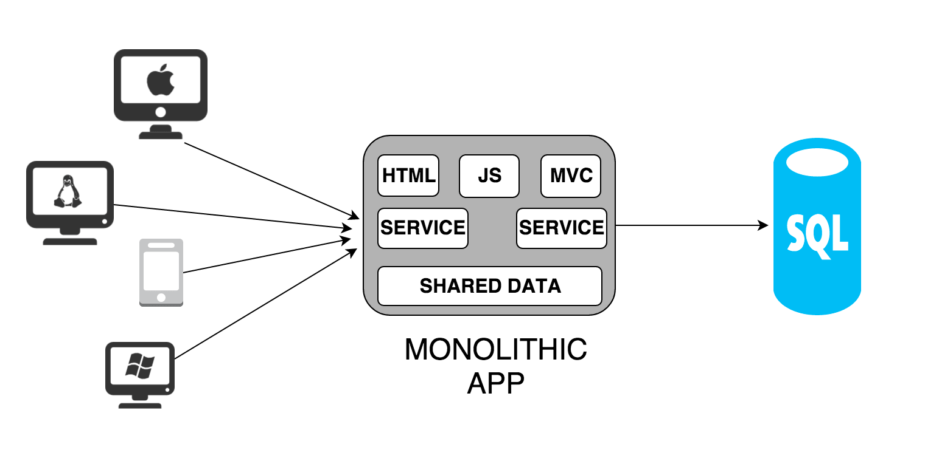
Monolith vs Microservices

Slide 10
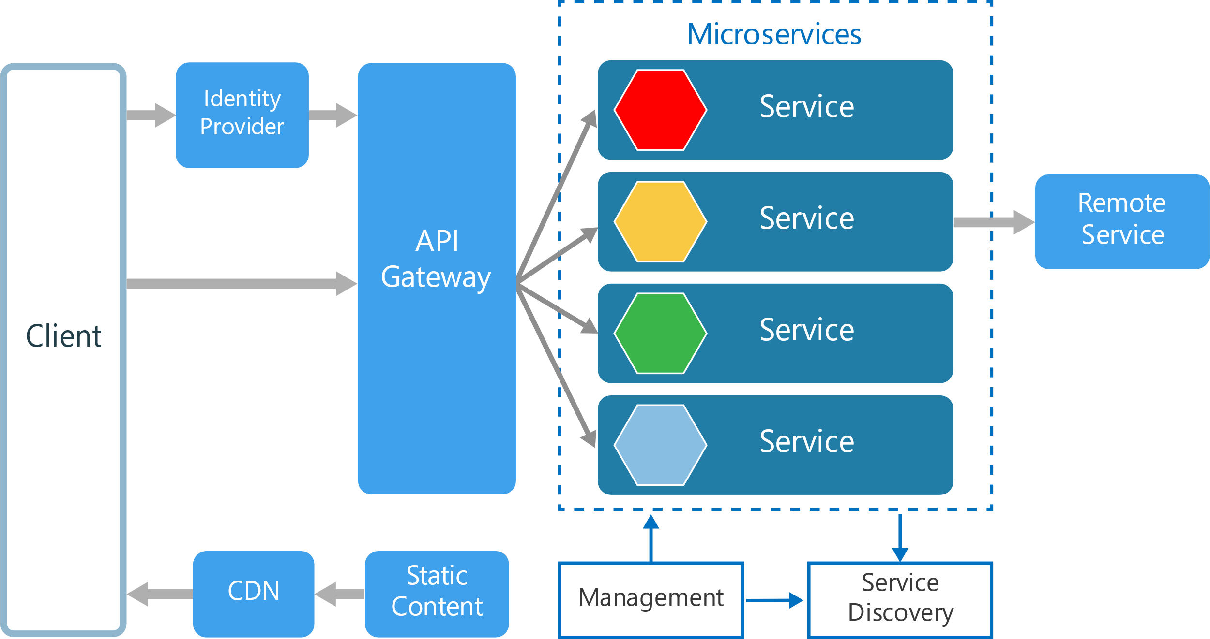
Monolith vs Microservices

Slide 11
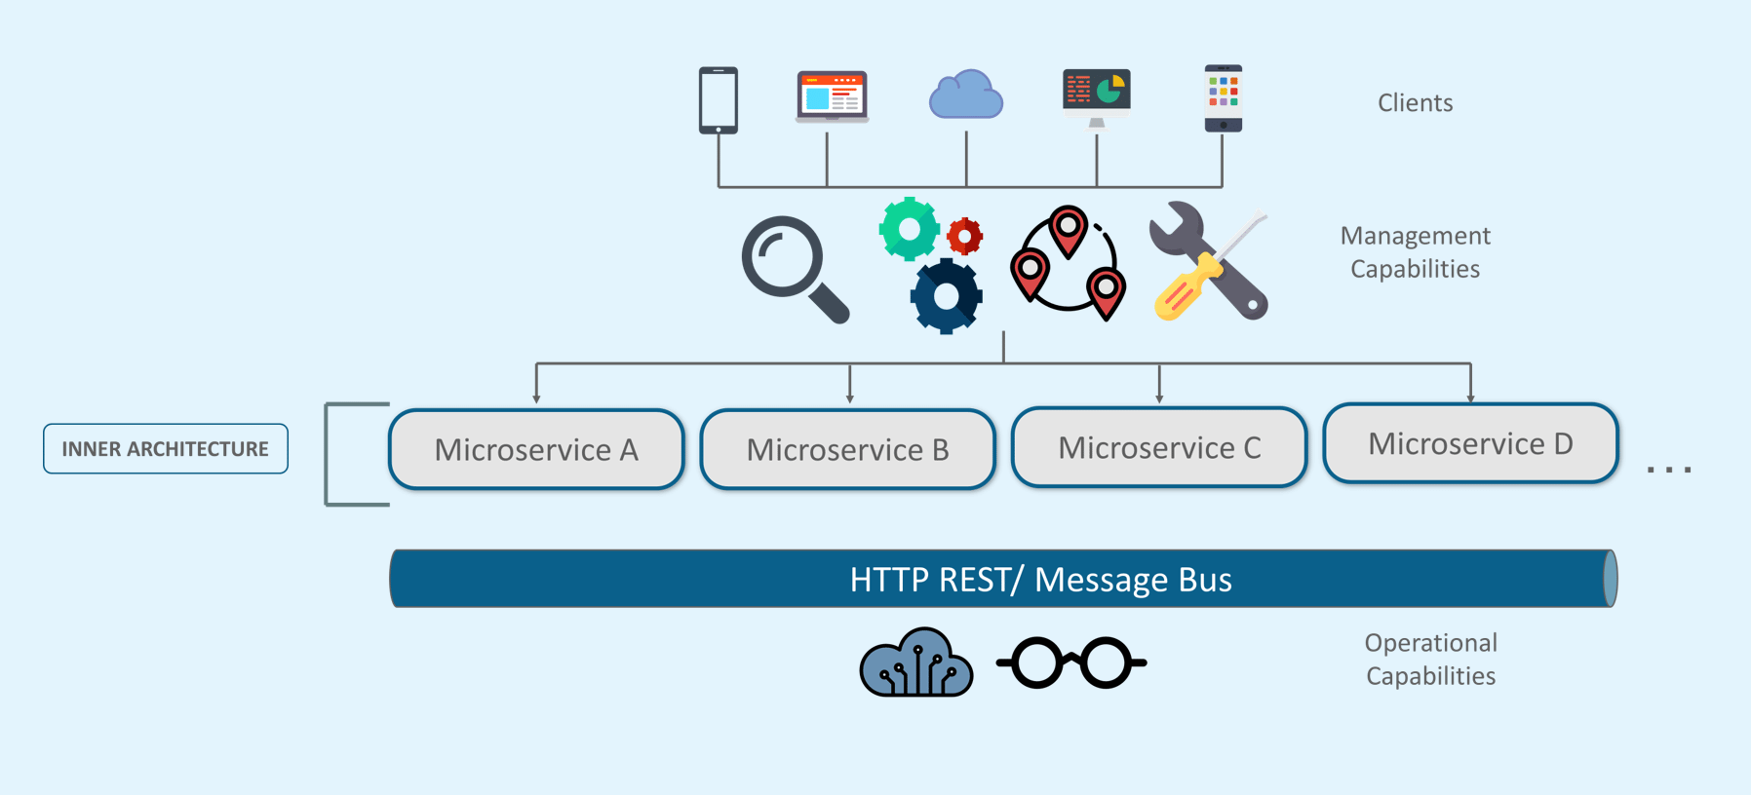
Monolith vs Microservices

Slide 12
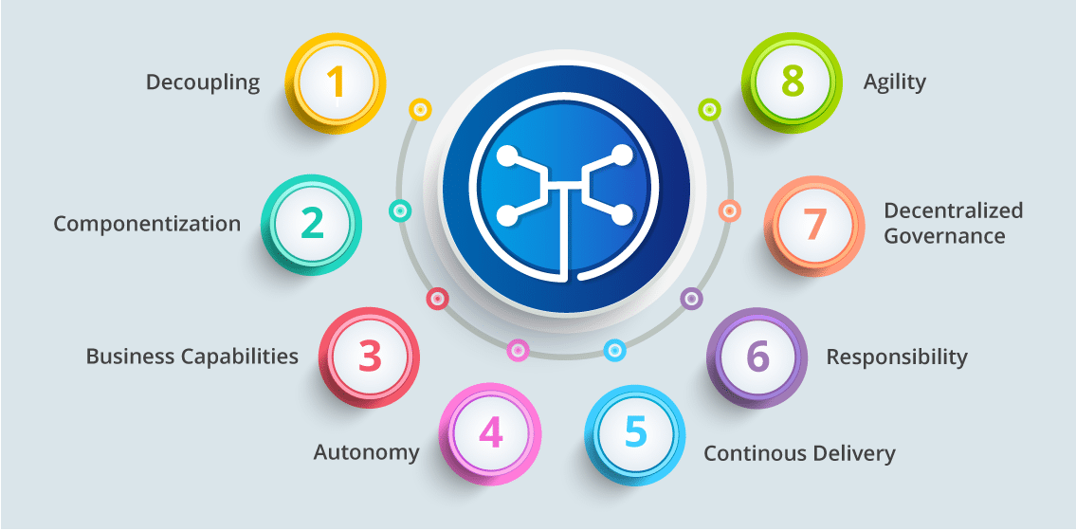
Microservices Features

Slide 13
Microservices Features
Decoupling – Services within a system are largely decoupled. So the application as a whole can be easily built, altered, and scaled
Componentization – Microservices are treated as independent components that can be easily replaced and upgraded

Slide 14
Microservices Features
Business Capabilities – Microservices are very simple and focus on a single capability
Autonomy – Developers and teams can work independently of each other, thus increasing speed

Slide 15
Microservices Features
Continuous Delivery – Allows frequent releases of software, through systematic automation of software creation, testing, and approval
Responsibility – Microservices do not focus on applications as projects. Instead, they treat applications as products for which they are responsible

Slide 16
Microservices Features
Decentralized Governance – The focus is on using the right tool for the right job. That means there is no standardized pattern or any technology pattern. Developers have the freedom to choose the best useful tools to solve their problems
Agility – Microservices support agile development. Any new feature can be quickly developed and discarded again

Slide 17
Advantages Of Microservices
Independent Development – All microservices can be easily developed based on their individual functionality
Independent Deployment – Based on their services, they can be individually deployed in any application

Slide 18
Advantages Of Microservices
Fault Isolation – Even if one service of the application does not work, the system still continues to function
Mixed Technology Stack – Different languages and technologies can be used to build different services of the same application

Slide 19
Advantages Of Microservices
Granular Scaling – Individual components can scale as per need, there is no need to scale all components together

Slide 20
Microservices pitfalls
Distribution - Distributed systems are harder to program, since remote calls are slow and are always at risk of failure.
Eventual Consistency - Maintaining strong consistency is extremely difficult for a distributed system, which means everyone has to manage eventual consistency.

Slide 21
Microservices pitfalls
Operational Complexity - You need a mature operations team to manage lots of services, which are being redeployed regularly.

Slide 22
Decomposition patterns

Slide 23
Decomposition Patterns
Decompose by Business Capability
Decompose by Subdomain
Strangler Pattern

Slide 24
Domain-driven design
Context - This is the setting in which a word or statement appears that determines its meaning.
Domain - This is a sphere of knowledge (ontology), influence, or activity. The subject area to which the user applies a program is the domain of the software.
Notes:
The software domain is not related to the technical terms, programming or computers in any way. In most projects, the most challenging part is to understand the business domain, so DDD suggests using a model domain; this is abstract, ordered, and selective knowledge reproduced in a diagram, code, or just words.

Slide 25
Domain-driven design
Model - This is a system of abstractions that describes selected aspects of a domain and can be used to solve problems related to that domain.
Ubiquitous language - This is a language structured around the domain model and used by all team members(domain experts and software experts) to connect all the activities of the team with the software.

Slide 26
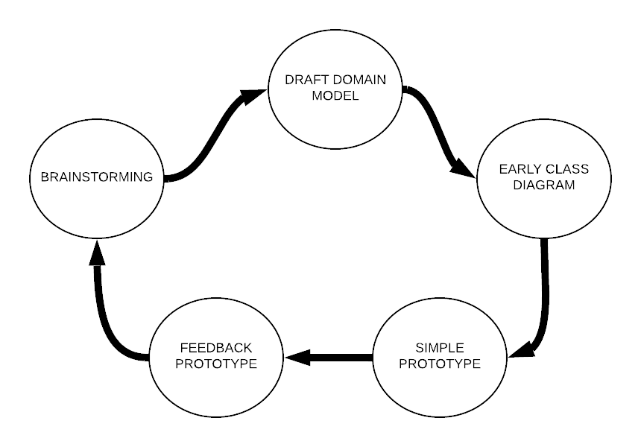
Steps to follow

Slide 27
Single knowledge block
Domain model
The ubiquitous language
Code

Slide 28
Ubiquitous language
Class names and their functions related to the domain
Terms to discuss the domain rules included on the model
Names of analysis and design patterns applied to the domain model
Notes:
https://www.dictionary.com/browse/ubiquitous

Slide 29
Bounded context
Domain consists of multiple bounded contexts. Each BC represents a domain function.
Bounded context for design encourages loose coupling and high cohesion
Notes:
https://www.dictionary.com/browse/ubiquitous

Slide 30
How DDD can help MS?
Scope
Size
Notes:
https://www.infoq.com/news/2016/02/ddd-microservices/

Slide 31
DDD in practice

Slide 32
Strangler pattern – When?
Migrate a legacy monolithic application to a microservice architecture
Notes:
https://www.infoq.com/news/2016/02/ddd-microservices/

Slide 33
Strangler pattern – How?
Transform — create a parallel new site with modern approaches.
Coexist — leave the existing site where it is for a time. Redirect from the existing site to the new one so the functionality is implemented incrementally.
Eliminate — remove the old functionality from the existing site.
Notes:
https://www.infoq.com/news/2016/02/ddd-microservices/

Slide 34
Strangler pattern – How?
Implement new functionality as services
Extract services from the monolith
Notes:
https://www.infoq.com/news/2016/02/ddd-microservices/

Slide 35
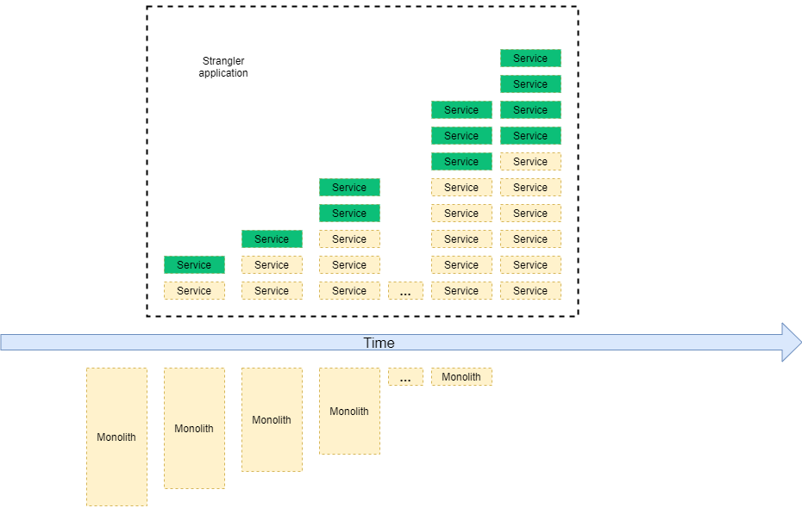
Strangler pattern – How?
Notes:
https://www.infoq.com/news/2016/02/ddd-microservices/

Slide 36
Decomposition patterns
Related patterns
Bulkhead Pattern
Sidecar Pattern
Notes:
https://www.infoq.com/news/2016/02/ddd-microservices/

Slide 37
Integration patterns

Slide 38
API Gateway – When?
There are multiple calls for multiple microservices by different channels.
There is a need for handling different types of Protocols.
Different consumers might need a different format of the responses.
Notes:
https://www.infoq.com/news/2016/02/ddd-microservices/

Slide 39
API Gateway
Centralizing access to microservices
Security/authentication
Traffic control
Load balancing
Logging and monitoring
Transformations
Circuit breaker
Caching
Notes:
https://www.infoq.com/news/2016/02/ddd-microservices/

Slide 40
API Gateway – How ?
Azure API Management
Google Apigee
Kong
Ocelot
Notes:
https://www.infoq.com/news/2016/02/ddd-microservices/

Slide 41
Integration patterns
Related patterns
Aggregator Pattern
Proxy Pattern
Chained Microservice Pattern
Branch Pattern
Notes:
https://www.infoq.com/news/2016/02/ddd-microservices/

Slide 42
Observability patterns

Slide 43
Cross-Cutting concern patterns

Slide 44

Feedback
Completați aici, în sală
Durează 2-3 minute
Feedback anonim - pentru formator si AgileHub
http://bit.ly/peakit003-feedback

